Slide 1






DevOps Concepts
Copyright © 2017 Tech Mahindra. All rights reserved.
1

Slide 2



TABLE OF CONTENT
Continuous Planning
Continuous Integration
Continuous Testing
Continuous Deployment
Trunk Based Development

Slide 3
Continuous Planning

Slide 4
Continuous Planning
What is Continuous Planning ?
A practice to establish business goals and adjusting the those based on business needs and customer feedback.
Why Continuous Planning?
Traditional waterfall models failed to accommodate the changing business requirements.
Continuous planning provides a platform for all stakeholders like the developers, business analyst, testers, and operations team to address the changing requirements
How Does it Function?
2. Share Innovative ideas
3. Perform demand management (Resources, Budget)
4. Define Plans (Release & Sprint)
5. Identify and Assign Tasks to Individual resources
1. Collaborate to Understand the Key requirements (Epics, User Stories)
6. Implement Automation
7. Track and maintain Traceability
8. Perform Risk Management
9. Perform Infrastructure Management
10. Dashboard Reporting

Slide 5
Key Benefits & Best Practices
Key Benefits
Best Practices
Backlog Grooming
Proliferate Lessons learnt & Best Practices from previous releases and Sprints
Increase Customer satisfaction
Static Testing & Risk Based Testing Approaches to eliminate ambiguities, missing requirements and Prioritization based on the risk assessed
Automatic Traceability of Changes
Reduce time and cost
Increase developer productivity & software quality
Defined Acceptance Criteria and Definition of Done
Transparent Governance and audit trail
Estimation technique
Centralized reporting & Tracking
Measure Performance : Dashboard Reporting using Burn down charts & Velocity

Slide 6


Continuous Planning: Demo Context
JIRA Software is an agile project management tool that supports any agile methodology, be it scrum, Kanban, or unique flavor. From agile boards to reports, planning, tracking, can be manage for all the agile software development projects from a single tool.
Business Requirements
Product Owner
Creates & Prioritize
Product Backlog (Epics, User Stories)
Sprint Planning & Estimate User stories
Team creates Tasks
& Take a Task
1
2
3
Communication thru JIRA is automated
User Stories and tasks are tracked within JIRA

Slide 7
Continuous Integration

Slide 8
Architecture & Development Challenge
Inefficiency and time loss in bonding and tracking Business Requirements documents and developments.
Lack of full integration of Architecture models in the continuous development process.
High response time and complexity in the delivery process for IST and UAT environments.
Long time frames for the code retrieval and promotion (Code Control and Code Deployment), as well as errors in the version management in Dimensions
Non efficient model to identify and attend the source code security vulnerabilities and huge time to execute the web scan analysis.
Lack of coverage in Unit Tests, most of them are manually executed at the end of the development process.
Lack of tools for code quality assurance (unused code, non-efficient code).
There is no linkage between test cases in IST and UAT
Very complex ecosystem, with a variety of development tools and environments, varying from Java and .Net thru Cobol and even Assembler

Slide 9
Continuous Integration
Improve technical debt, reduce application risk
Ability to include frequent changes
What is Continuous Integration
Why Continuous Integration?
Continuous Integration is a software development practice where members of a team integrate their work frequently; usually, each person integrates at least daily… Each integration is verified by an automated build… to detect integration errors as quickly as possible
Why Continuous Integration?
2. When done, commit the changes to the repository
3. The CI server monitors the repository and checks out changes when they occur.
4. The CI server builds the system and runs unit and integration tests.
5. The CI server releases deployable artefacts for testing.
1. Developers check out code into their private workspaces.
6. The CI server assigns a build label to the version of the code it just built
7. The CI server informs the team of the successful build.
8 . If the build or tests fail, the CI server alerts the team
9. The team fix the issue at the earliest opportunity.
10.
Keep on continually integrate and test throughout the project.

Slide 10
Key Benefits & Best Practices
Key Benefits
Best Practices
Left-Shift strategy & Early detection of defects
Single source repository
Increase developer productivity and software quality
Automate the build
Deliver stable source code pakage
Enable the self test for build
Agile Development
Make it easy for anyone to get the latest executable
Bridge with QA and deployment
Automate the deployment
Keep the build fast

Slide 11






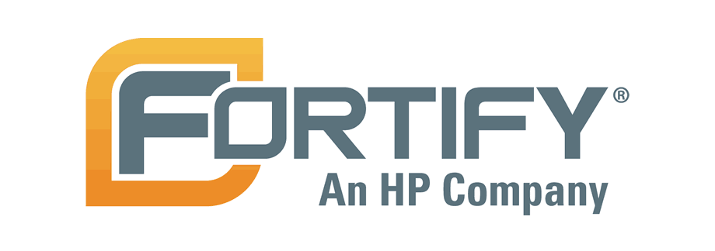

Continuous Integration: Demo Context
Auto Env Request
/Provisioning
Development & Peer Review
Get the last version of the code from
Package Creation
Automated Unit Testing
1
2
3
4
10
Orchestration
5
9
Promote the code to release to QA branch
Automated Code Quality Analysis
Automated Vulnerability Analysis
Automated Code Coverage
8
7
6
Source Code Control using BitBucket.
Automated and Mandatory Unit Test Process.
Automated Code Coverage and Unit Test Report.
Automated Vulnerability Test using HP Fortify.
Automated Code Quality Review with SonarQube.
Enhanced control over source code version.

Slide 12
Continuous Testing

Slide 13
Continuous Testing
What is Continuous Testing?
A practice to test the changing requirements, enable quicker delivery and verify the quality of the output delivered.
Why Continuous Testing?
In case of traditional testing, the requirements and test cases are frozen and are not expected to change for release cycle. This contradicts agile development and continuous delivery model where requirements are “expected” to change. Continuous Testing addresses the dynamic changing nature of requirements and provide mechanisms to validate the quality of the product with respect to requirements.
How Does it Function?
1. Shift left testing Approach ( perform testing much earlier in the SDLC process)
2. Apply lean principles – Continuously test what is changed, reduce rework and effort
3. Use Service Virtualization techniques to reduce dependency to perform testing
4. Ensure production ready code in quick time (faster time to market) as part of continuous delivery
5. Automation to reduce manual effort and errors
6. Collaboration between team members and view the system as a whole rather than testing as a separate piece.
7. Implement Defect Management Processes and defect prevention strategies
8. Define & Collect Metrics
9. Dashboard Reporting
10. Faster Time to Market

Slide 14
Key Benefits & Best Practices
Key Benefits
Best Practices
Defined Test Strategy
Utilize Lessons Learnt
Test Early
Test Often
Static Testing
Risk Based Testing
Service Virtualization
Test Data Management
Test Automation
Defect Management
Automated Testing
Uninterrupted Testing through Service Virtualization
Faster Time to Market
Increased Quality
Increased Customer Satisfaction
Centralized Reporting
Metrics
Increased Traceability

Slide 15






Continuous Testing: Demo Context
Test Planning
Auto Functional (Manual) Test Cases Generation
Automation
of Functional Test Scripts using eTA/ Historic Approach
Service
Virtualization
1
2
3
9
Orchestration
4
8
Automated Deployment Approvals
Automation of Regression Test Scripts and Execution
Automated Execution of Functional Test
Auto Code Deployment into Testing Environment
7
6
5
15

Slide 16
Continuous Deployment
Continuous Testing

Slide 17
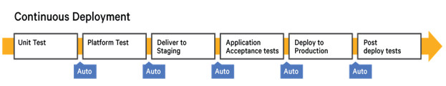
Continuous Deployment
What is Continuous Deployment?
Continuous deployment is the practice of releasing every good build to production seamlessly and automatically once the code checked into version control.
Continuous Deployment mandates Continuous Delivery, but the opposite is not required.
Continuous deployment special is deploying every change that passes the automated tests (and optionally a short QA gate) to production.
Benefits
Releasing no longer involved coordination with other people, or searching for low-usage windows of time, or performing manual steps.
Continuous deployment further can be refined to break work down into small, valuable pieces that could be deployed.
Because we release small amounts of code, it's easier to discover any problems and fix them quickly.
It helps to quickly flow valuable improvements and fixes to our customers.

Slide 18
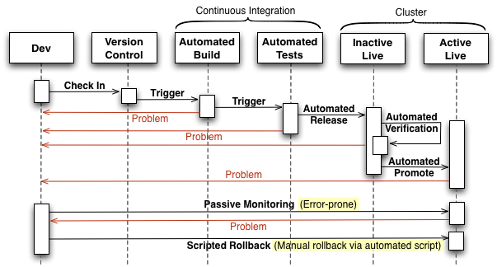
Automated release-to-production process
Principles:
Deployment pipelines tie together configuration management, continuous integration and test and deployment automation.
Only build packages once and deploy them the same way to every environment.
Maintain Infrastructure that supports Continuous Deployment e.g. Clustered Environment Setup.

Slide 19
Trunk Based Development

